Slide 1
Oracle Procedures

Slide 2
Example Procedure #1
The Create or replace statement specifies the name of the procedure and optionally Input and Output Parameters. Parameters should be prefixed with P_ and end with _IN or _OUT indicating the type of parameter. *Note comments created after the Create statement are saved in the database as part of the procedure
CREATE OR REPLACE PROCEDURE PR_XXJS_WRITE_DEBUG( p_text_in IN VARCHAR2)
--
-- Writes debugging data to the xxjs_debug table
--
IS
PRAGMA AUTONOMOUS_TRANSACTION; --This statement makes the procedure run in it's own transaction
--So it doesn't matter if the calling procedure issues a rollback
---------------------------------------------------------------------------
-- L o c a l V a r i a b l e --
---------------------------------------------------------------------------
lvDemoString VARCHAR2(100);
lvDemoNumber NUMBER;
--------------------------------------------------
-- B E G I N --
--------------------------------------------------
BEGIN
INSERT INTO XXJS_DEBUG ( text, created_by, date_created )
VALUES ( p_text_in, USER, SYSDATE );
COMMIT;
--------------------------------------------------
-- E X C E P T I O N B L O C K --
--------------------------------------------------
EXCEPTION
WHEN OTHERS THEN DBMS_OUTPUT.put_line('PR_XXJS_WRITE_DEBUG has aborted. SQLCODE ' ||SQLCODE
|| ' SQL Message ' || SQLERRM);
END;
/
PRAGMA AUTONOMOUS_TRANSACTION this statement makes the code run in it’s own transaction and will not be impacted by commit or rollback statement from the code that calls the procedure. Only required in certain scenarios, like writing a debug table
Local Variables need to be defined before the Begin Statement
The actual procedure code is between the first BEGIN statement and the EXCEPTION block.
If the procedure calls SQL Statements to Insert, Update or Delete a COMMIT must be executed to save the updates.
The EXCEPTION block is invoked if a SQL error is detected in the code. *Note if no Exception block is coded this will cause the error to be thrown in the calling code

Slide 3
Supporting Objects for Example Procedure #1
CREATE SEQUENCE XXJS_DEBUG_SEQ
START WITH 1
MAXVALUE 999999999999999999999999999
MINVALUE 1
NOCYCLE
CACHE 20
NOORDER;
CREATE TABLE XXJS_DEBUG
(
SEQ_NO NUMBER NOT NULL,
TEXT VARCHAR2(4000 BYTE),
PROCEDURE_NAME VARCHAR2(100 BYTE),
CREATED_BY VARCHAR2(20 BYTE) NOT NULL,
DATE_CREATED DATE NOT NULL,
CLIENT_PROGRAM_NAME VARCHAR2(400 BYTE),
PRIMARY KEY (SEQ_NO)
);
CREATE OR REPLACE TRIGGER JSDEBUG_BI_CR BEFORE INSERT
ON XXJS_DEBUG REFERENCING OLD AS OLD NEW AS NEW FOR EACH ROW
--------------------------------------------------------------------------------
-- Before Insert Trigger on table XXJS_DEBUG --
-- Author: Jim Slanker created June 2nd 2022 --
--------------------------------------------------------------------------------
DECLARE
-------------------------------------------------------------------------------
-- B E G I N Trigger Code --
-------------------------------------------------------------------------------
BEGIN
:NEW.created_by := USER;
:NEW.date_created := SYSDATE;
:NEW.seq_no := xxjs_debug_seq.NEXTVAL;
IF :NEW.procedure_name is NULL THEN
:NEW.procedure_name := sys_context('USERENV','MODULE');
ELSE
:NEW.procedure_name := SUBSTR(:NEW.procedure_name || ' '
|| sys_context('USERENV','MODULE'),1,100);
END IF;
:NEW.client_program_name := sys_context('USERENV','CLIENT_PROGRAM_NAME');
-------------------------------------------------------------------------------
-- E N D Trigger Code --
-------------------------------------------------------------------------------
END;
/

Slide 4
Testing Procedure #1 from SQLPlus
EXECUTE PR_XXJS_WRITE_DEBUG(‘Testing 1 2 3’);
SELECT * FROM XXJS_DEBUG;

Slide 5
Example Procedure #2
CREATE OR REPLACE PROCEDURE SANDBOX.PR_XXJS_EMPLOYEE_REPORT
IS
---------------------------------------------------------------------------
-- L o c a l V a r i a b l e --
---------------------------------------------------------------------------
lvName XXJS_EMPLOYEES.NAME%TYPE;
lvSqlStatement number;
-----------------------------------------------------------------------------
-- Cursor to Read Active Employees in XXJS_EMPLOYEES Table --
-----------------------------------------------------------------------------
CURSOR crGetEmployees is
SELECT name,
decode(employee_type,'SALARY','Annual $' ||annual_salary,
'Hourly $' ||hourly_rate) Compensation,
hire_date
FROM XXJS_EMPLOYEES
WHERE TERMINATION_DATE is NULL -- Only Select Active Emloyees
ORDER BY name;
BEGIN
------------------------------------------------------------------
--Write Report Heading --
------------------------------------------------------------------
DBMS_OUTPUT.put_line(RPAD('Name',30,' ') || RPAD('Compensation',30) || RPAD('Hire Date',10));
---------------------------------------------------------------------------
-- Loop through XXJS_EMPLOYEES table rows for active employees --
---------------------------------------------------------------------------
lvSqlStatement := 1;
FOR frGetEmployees in crGetEmployees
LOOP
DBMS_OUTPUT.put_line(RPAD(frGetEmployees.name,30) || RPAD(frGetEmployees.compensation,30) || RPAD(frgetEmployees.hire_date,10));
END LOOP;
EXCEPTION
WHEN OTHERS THEN DBMS_OUTPUT.put_line('PR_XXJS_EMPLOYEE_REPORT has aborted. SQLCODE ' ||SQLCODE
|| ' SQL Message ' || SQLERRM || ' Sql Statement ' || lvSqlStatement);
------------------------------------------------------------------
-- Call Debug Routine --
------------------------------------------------------------------
PR_XXJS_WRITE_DEBUG('PR_XXJS_EMPLOYEE_REPORT has aborted. SQLCODE ' ||SQLCODE
|| ' SQL Message ' || SQLERRM || ' Sql Statement ' || lvSqlStatement);
END;
/
The CURSOR defines the SQL to execute and is done instead of directly issues SELECT statement in the Code
This is a CURSOR Loop the frGetEmployees is a definition of a recordset and all fields in CURSOR will be available to it
If the code errors out the Exception code is executed this includes sending the error message to the DBMS_OUTPUT and also calls the Example Procedure #1 which writes to the Debug table XXJS_DEBUG

Slide 6

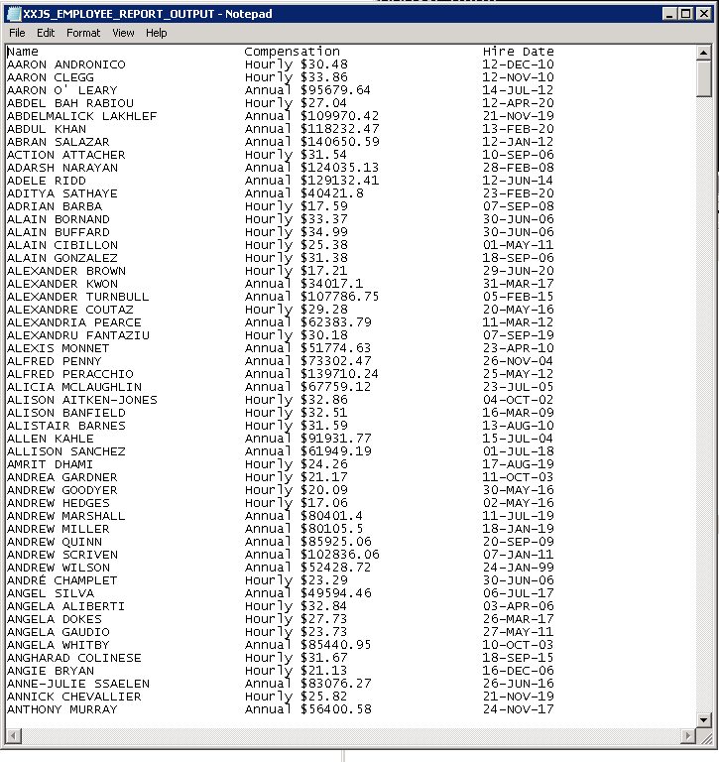
Testing Procedure #2 from SQLPlus
-----------------------------------------------------------------------------------------
-- Filename = RUN_XXJS_EMPLOYEE_REPORT.sql --
-- Author: Jim Slanker --
-- Date: June 3rd 2022 --
-----------------------------------------------------------------------------------------
set serveroutput on
set define on
--------------------------------------------------------------------------------
-- Start Commands to Spool Output for logging of script Execution --
-- spool off command is needed at the end of the script to close the log file --
--------------------------------------------------------------------------------
spool XXJS_EMPLOYEE_REPORT_OUTPUT.txt
EXECUTE PR_XXJS_EMPLOYEE_REPORT;
set define on
PROMPT >> End of RUN_XXJS_EMPLOYEE_REPORT Script
------------------------------------------------------------
-- The following command will close the spool output file --
spool off;

